Slide 1
Incident Command Team
How Akron Zoo utilizes the ICS

Slide 2
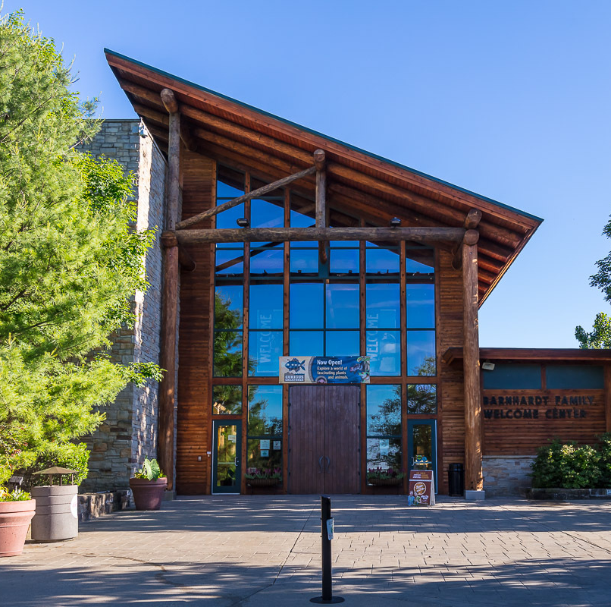
Akron Zoo
The Akron Zoo is located inside Akron City, Ohio with residential homes surrounding zoo property.
Currently, Akron Zoo occupies 77 acres with 35 acres developed with habitats, guest amenities and support facilities
Less than 200 year-round employees
300-400k visitors year round

Slide 3
Akron Zoo's Version of the Incident Command System
We used the Incident Command System to develop what we call the Incident Command Team (ICT).
This team consists of 7 roles that are filled every day we have guests on grounds
We have a modified ICT if we are not open but still need a version of the command team present
Some members of the ICT are on a call list for after hour emergencies like power outages or LSS alarms

Slide 4
Akron Zoo Incident Command Team
Notes:
Incident Commander-In charge of the ICT daily, they coordinate responses and ensure procedures are followed
Documentation Specialis-logs daily information, codes and is the point person if 911 needs to be called
Guest Chief-responsible for guest safety during the day
Animal Chief-responsible for animal safety, and keeper safety
Immobilization-responsible for animal recapture
Facilities Chief-responsible for physical assets safety
Public Information Officer-responsible for any media/external communciation

Slide 5
ICS Simplified
Before we had our current system, we had an Emergency Response Team (ERT)
There were several different roles that only activated during specific emergencies and the training was different for each role
Our code system was numbered so staff had to remember what each number meant for which code
After establishing our new system
We have 7 everyday roles that are manned when guests are on grounds, we use a modified ICT when we are operating without guests or during small events
We switched to plain speech codes, so staff do not need to think about what emergency is happening

Slide 6
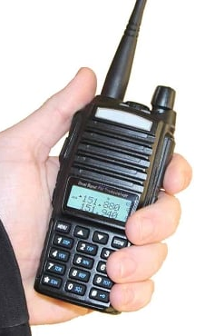
How our ICT is established Daily
The first roles to check in are Incident Commander, Animal Chief, Facilities Chief and Immobilization.
Once these roles complete a radio call, we are able to shift animals
If any of the 4 rolls miss radio call, we are unable to shift animals
These 4 roles are the key responders in all animal emergencies
We use our local PD as our firearms team for any Dangerous Animal escape
15 minutes prior to opening the final 3 roles check in on the radio and the ICT is formally in place

Slide 7
Staffing Incident Command
We are a 361-day operation, only closing on Thanksgiving, Christmas Eve, Christmas and New Years Day
Our 7 ICT roles are filled daily with staff across every department
The majority of our Admin staff work Mon-Fri, their responsibility to the ICT has them working 1 weekend day a month, sometimes 2
Some departments split their weeks by Sun-Thurs and Tues-Sat where their ICT role will always fall on their regularly scheduled weekend day
Schedules are posted for most roles for 6 months at a time allowing staff plenty of time to schedule around their weekend shifts
Event shifts are sent out to the entire ICT so staff are able to choose the days they can work in advance

Slide 8
Incident Command Training
Onboarding new members to the ICT looks different for the different roles.
Each role is responsible for training new ICT members under the guidance of the Safety Manager.
Animal Chief and Facilities Chief fill their roles as soon as their training is done, and the new staff member is comfortable. The first few shifts are done through shadowing a more experienced ICT member
Other ICT roles will generally wait 6 months prior to their first assigned shift
This is to allow staff to acclimate to the zoo and for the new schedule to post

Slide 9
Incident Command Team Drills
All staff are required to participate in the mandatory AZA Drills, the ICT is required to participate in additional tabletop drills prior to the AZA Drill
Tabletops help create an understanding across the ICT on what each role is responsible for during emergencies
Allows the team to have a discussion without the pressure of responding to an emergency or during a drill
The Safety Manager has mandatory tabletop training with ICT role groups for specific role training

Slide 10
ICT Daily Responsibilities
Staff work as ICT members on top of their daily tasking
Staff are assigned an ICT role based on their position in the zoo. These roles are discussed during the interview process so oncoming staff know about the responsibility prior to onboarding
We have two active ICT roles that take on additional tasking outside of emergencies each day, Facilities Chief and Animal Chief
Documentation Specialists have a daily report they are required to fill each day
Most roles are able to work their assigned job on top of the ICT role with little to no additional tasking
When an emergency is called responding ICT members leave what they are working on until the emergency code is cancelled

